Slide 1
Lecture 6: Order Management and Dimension Patterns
Chapter 6

Slide 2
Recap: Slowly Changing Dimensions
Type 0: Retain Original
Type 1: Overwrite
Type 2: Add New Row
Type 3: Add New Attribute
Type 4: Add Mini-Dimension
Type 5: Add Mini-Dimension and Type 1 Outrigger
Type 6: Add Type 1 Attributes to Type 2 Dimension
Type 7: Dual Type 1 and Type 2 Dimensions

Slide 3
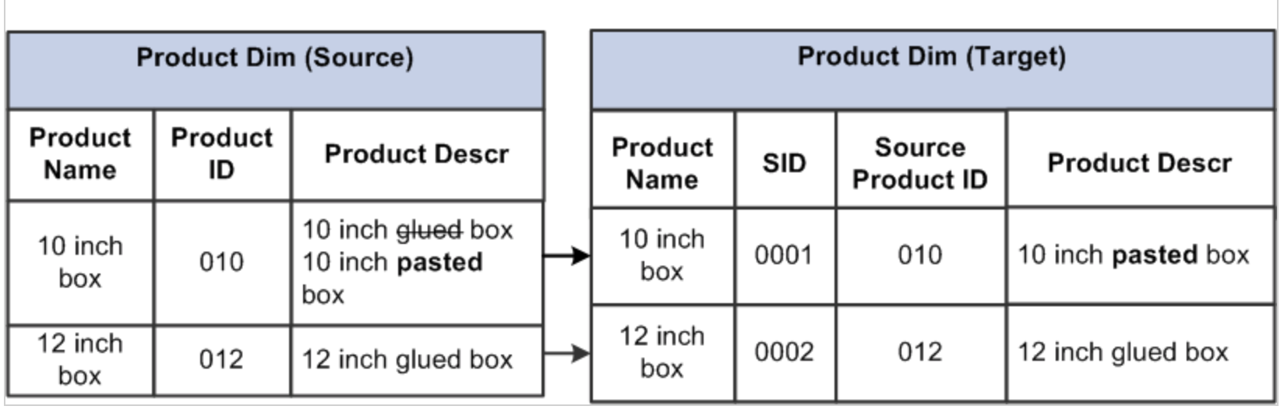
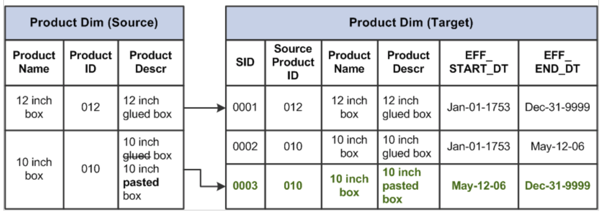
Slowly Changing Dimensions Examples

Slide 4
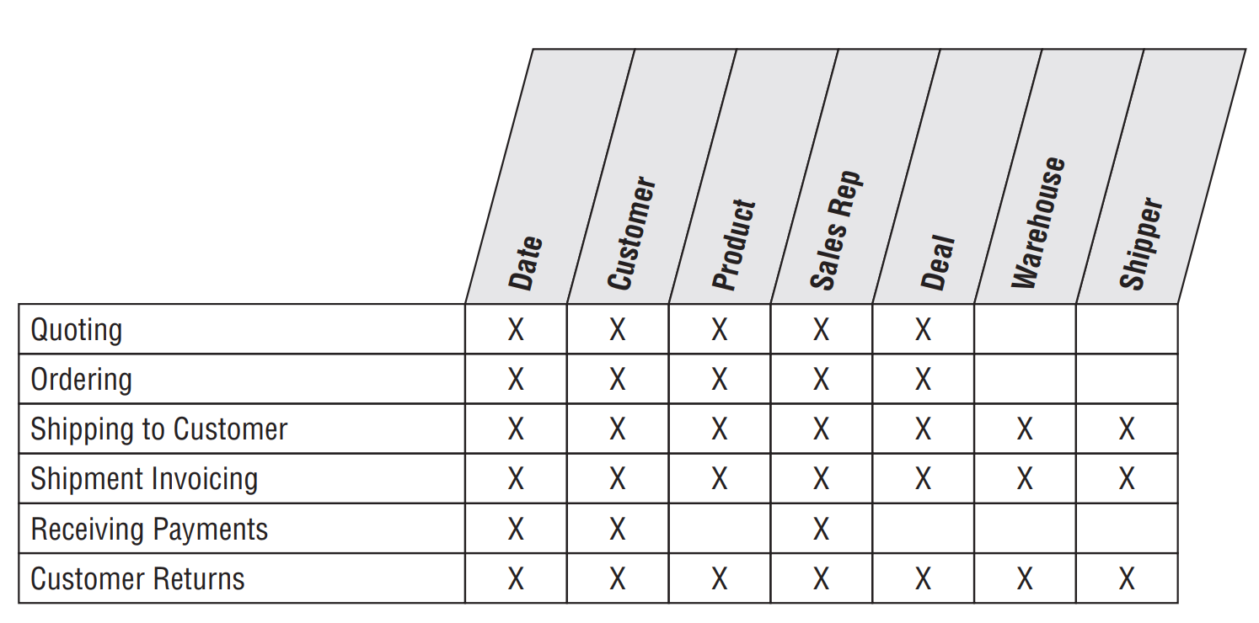
Order Management Bus Matrix

Slide 5
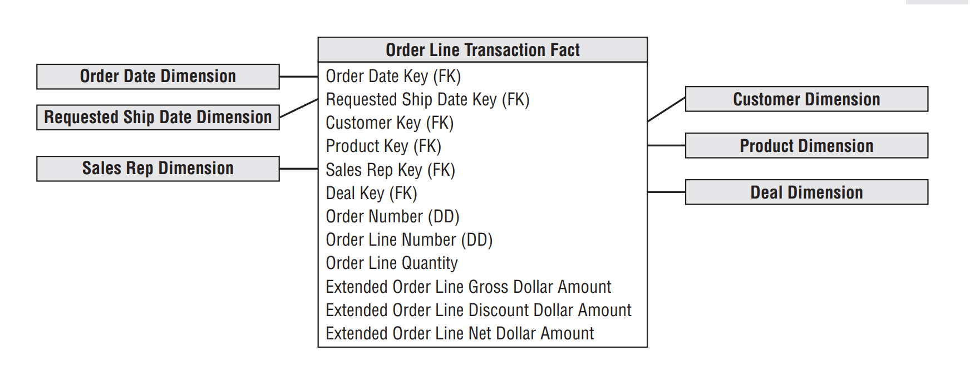
Order Transactions
The natural granularity for an order transaction fact table is one row for each line item on an order.

Slide 6
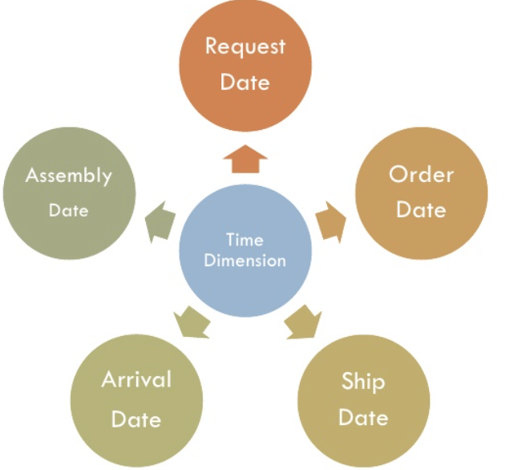
Dimension Role-Playing
Role-Playing: occurs when a single dimension simultaneously appears several times in the same fact table;
Date dimension is found in every fact table because we are always looking at performance over time.

Slide 7
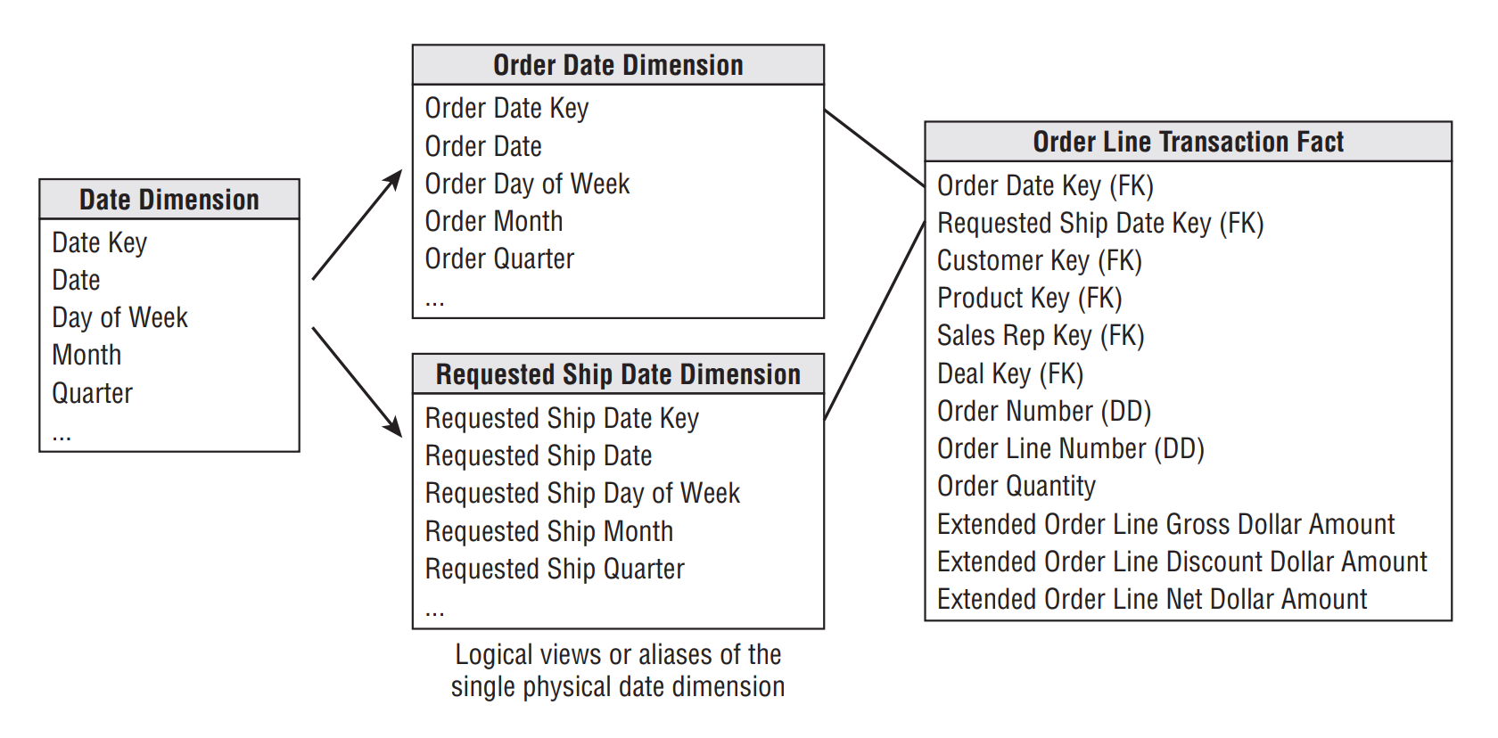
Role-playing date dimensions
Date dimension serves different roles in a single fact table.
Each role is a separate view of underlying single physical table.
Each view should be uniquely labeled to distinguish from the others.

Slide 8
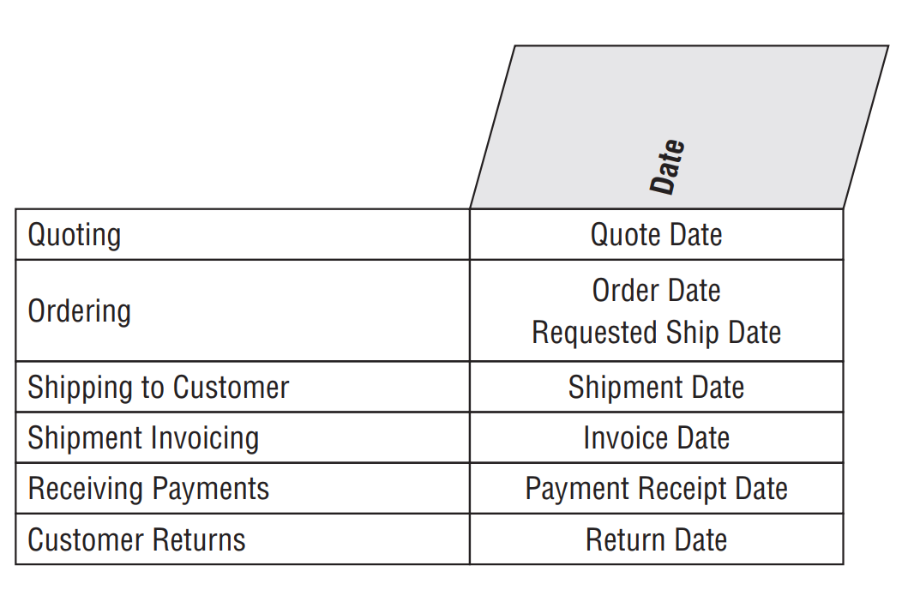
﻿Role Playing and the Bus Matrix

Slide 9
Product Dimension Revisited
Product dimension describes the complete portfolio of products sold by a company:
Characteristics of Product dimension:
Numerous verbose descriptive columns;
One or more attribute hierarchies in addition to many nonhierarchical attributes;
From master file to dimension table:
﻿Remap the operational product code to a surrogate key.
﻿Add descriptive attribute values to augment or replace operational codes.
﻿Quality check the attribute values to ensure no misspellings, impossible values, or multiple variations.
﻿Document the attribute definitions, interpretations, and origins in the metadata.

Slide 10
Customer Ship-To Dimension
The customer ship-to dimension contains one row for each discrete location to which we ship a product.
Common hierarchy is natural geographic, customer’s organizational.
Country -> Region -> Province -> Address
Bill’s number -> Customer Name -> Customer Organization Name -> Customer Corporate Parent Name;

Slide 11
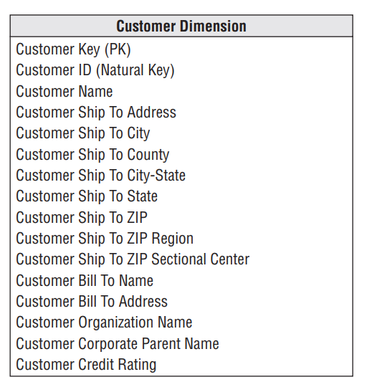
Customer Ship-To Dimension

Slide 12
Junk Dimensions
A junk dimension is a convenient grouping of typically low-cardinality flags and indicators.
﻿Transaction indicator or transaction profile dimension;
Why have junk dimension, other alternatives:
Ignore the flags and indicators;
Leave flags and indicators unchanged in the fact table row;
Make each flag, indicator into its own separate dimension;
Strip out all the flags and indicators from the design.

Slide 13
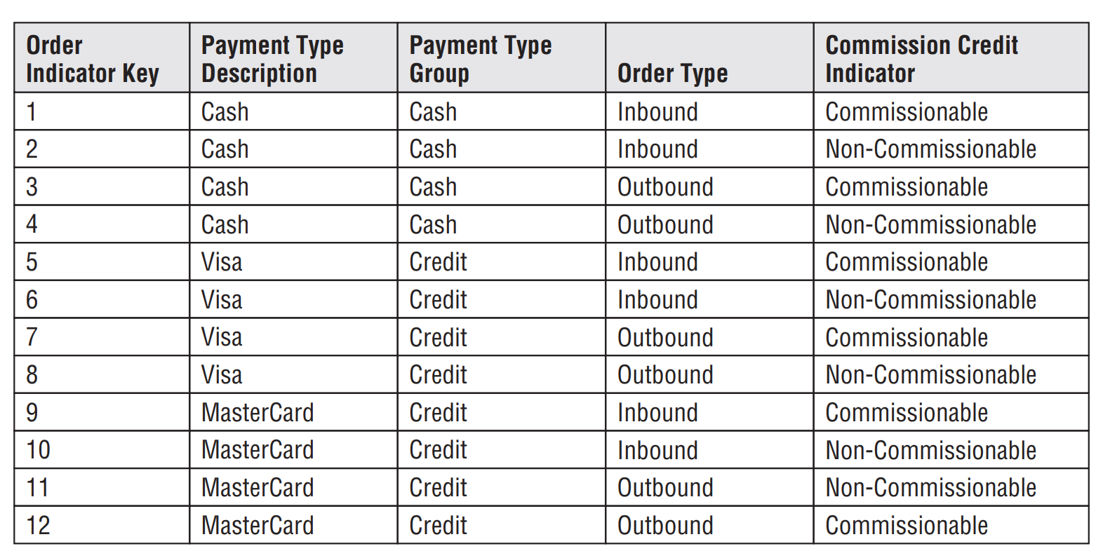
Junk Dimension
﻿Sample rows of order indicator junk dimension:

Slide 14
﻿Multiple Currencies
Multiple Currencies: Expressed in both local currency and the standardized corporate currency;
Each order fact would be replaced with a pair of facts, one for the applicable local currency and another for the equivalent standard corporate currency;
﻿Supplement ﻿the fact table with a currency dimension to identify the currency type associated with the local currency facts;
Currency dimension is needed even with location, ﻿because the location does not necessarily guarantee which currency was used;

Slide 15
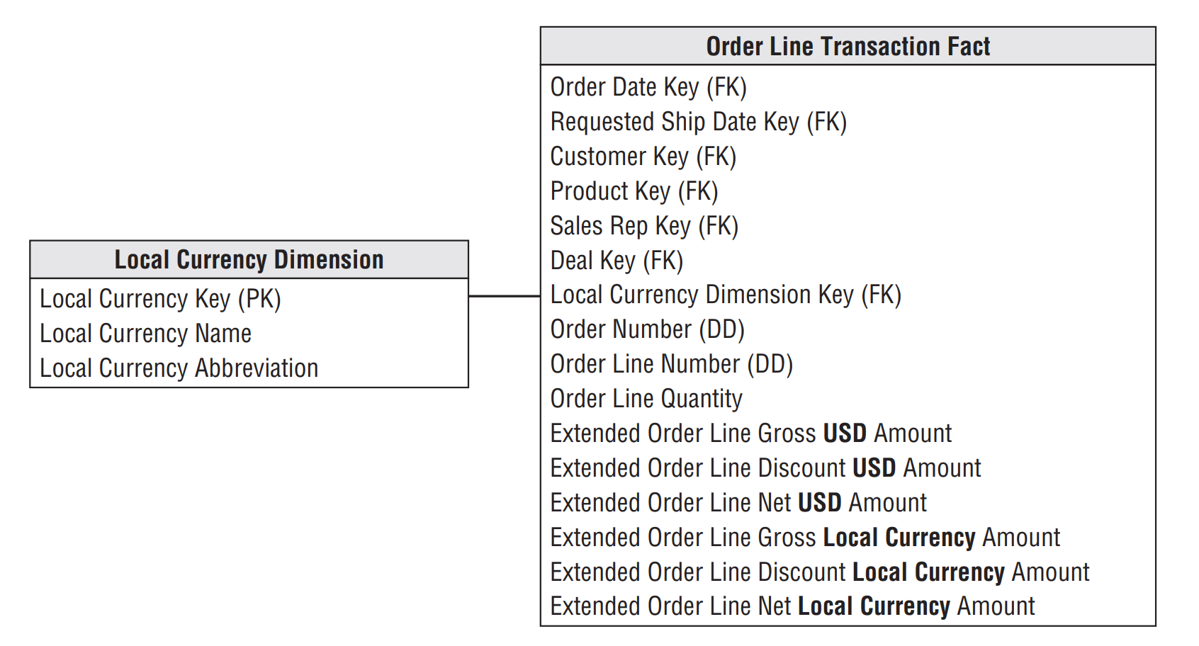
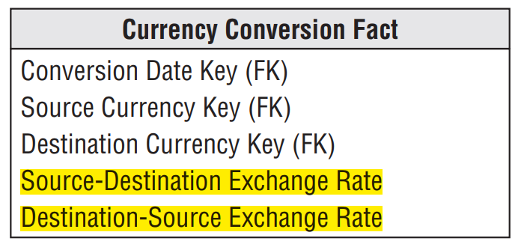
﻿Metrics in multiple currencies within the fact table
Supports reporting of facts in multiple currencies
Supports reporting of facts in two currencies

Slide 16
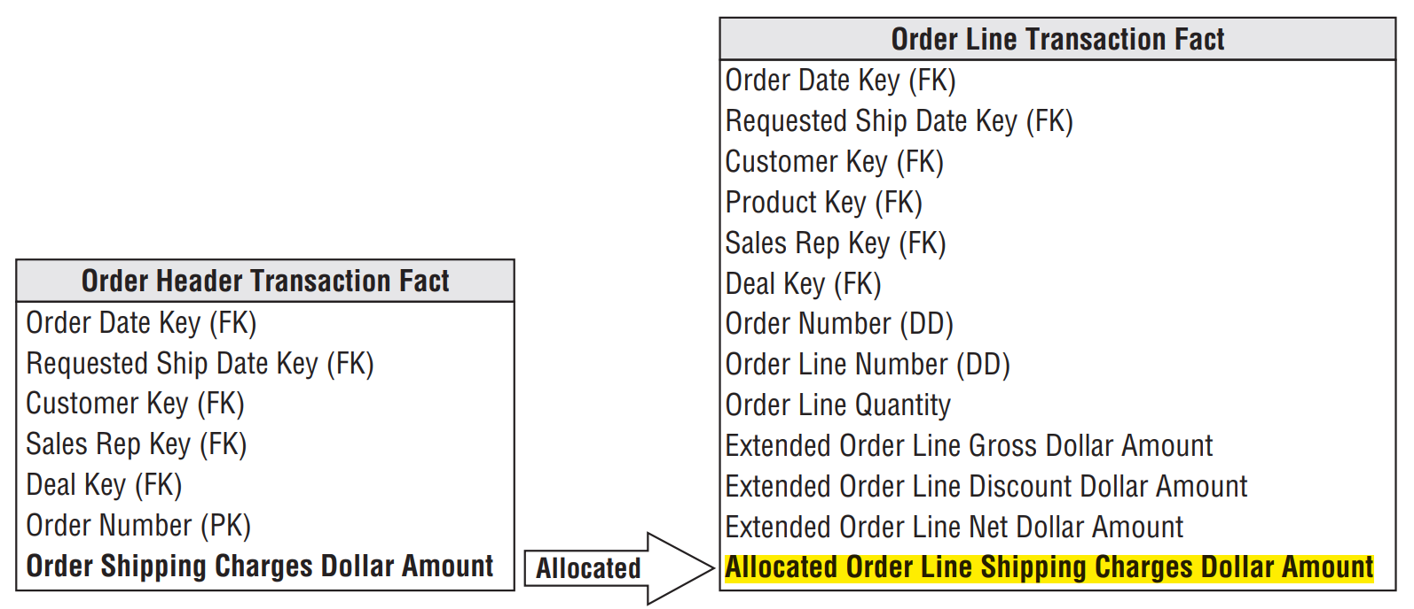
Header and Line Item Facts with Different Granularity
Should not mix fact granularities ( For example, order and order line facts) within a single fact table;
Allocating header facts to the line item:
When header facts are allocated to the line level, we are able to analyze them by the product dimension
The product dimension is absent from the header fact table

Slide 17
﻿Alternative techniques for handling header/line facts at diﬀerent granularity
﻿Repeat the unallocated header fact on every line.
﻿Store the unallocated amount on the transaction’s first or last line.
﻿Set up a special product key for the header fact.

Slide 18
Invoice Transactions
Occurs when products are shipped from our facility to the customer
Each item corresponding to a product being shipped;
Various prices, discounts, and allowances are associated with each line item;

Slide 19
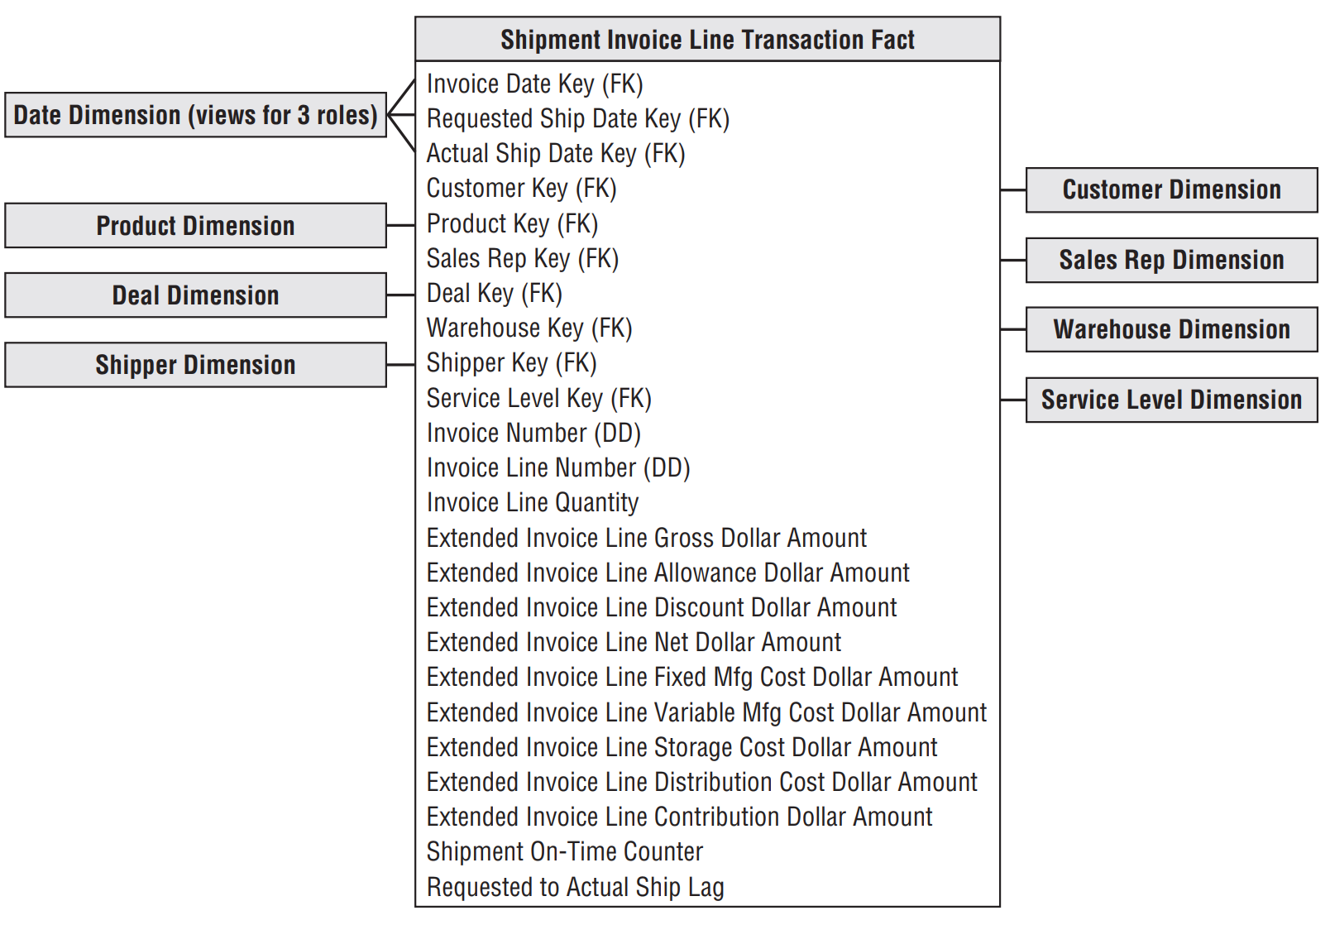
﻿Shipment invoice fact table

Slide 20
Invoice Transactions
From invoice fact table we can see
All company’s products;
All customers;
All contract and deals;
All off-invoice discounts and allowances;
All revenue;
All variable and fixed costs (manufacturing, delivering);
All money left over after delivery of a product
Customer satisfaction metrics;

Slide 21
Business Users may need to know:
What is my confidence in these reported numbers?
Were there any anomalous values encountered while processing this source data?
What version of the cost allocation logic was used when calculating the costs?
What version of the foreign currency conversion rules was used when calculating the revenues?

Slide 22
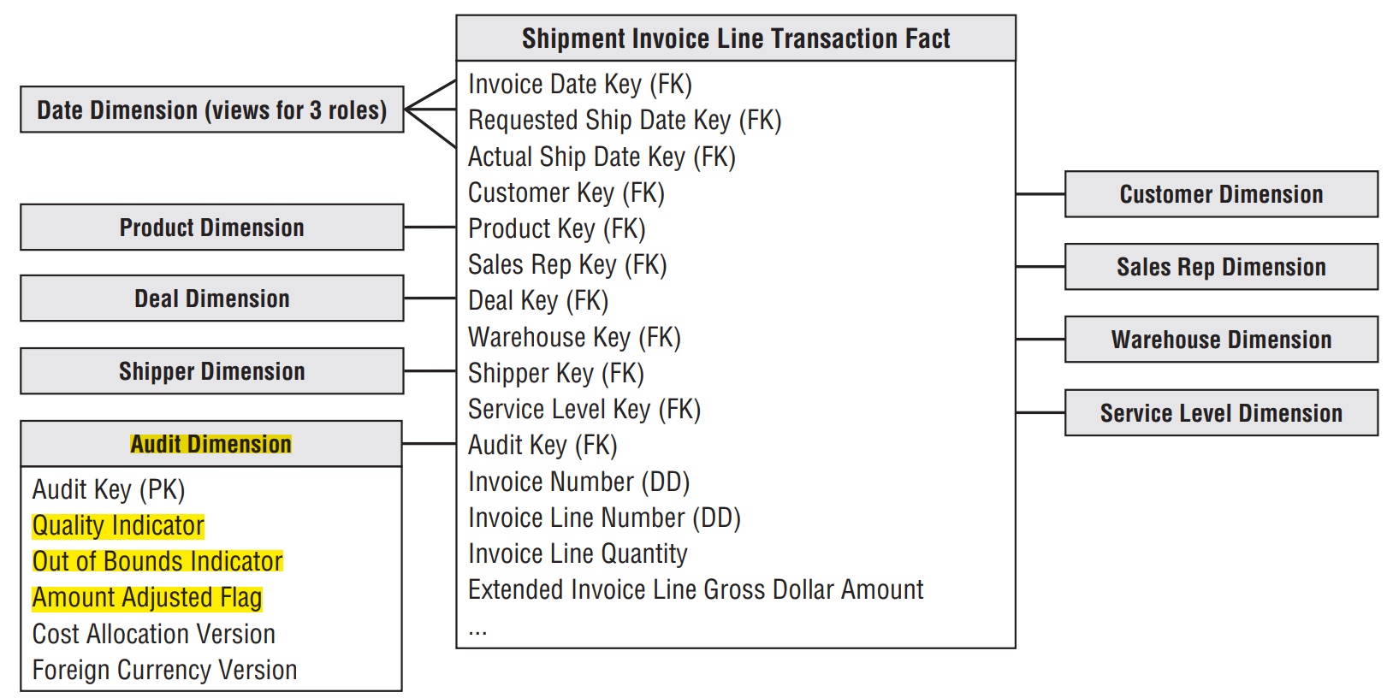
﻿Audit Dimension
﻿Sometimes information is required from the metadata such as
data quality
out of bounds indicator
foreign currency version
﻿unusual processing requirements
Create an audit dimension containing the metadata conditions

Slide 23
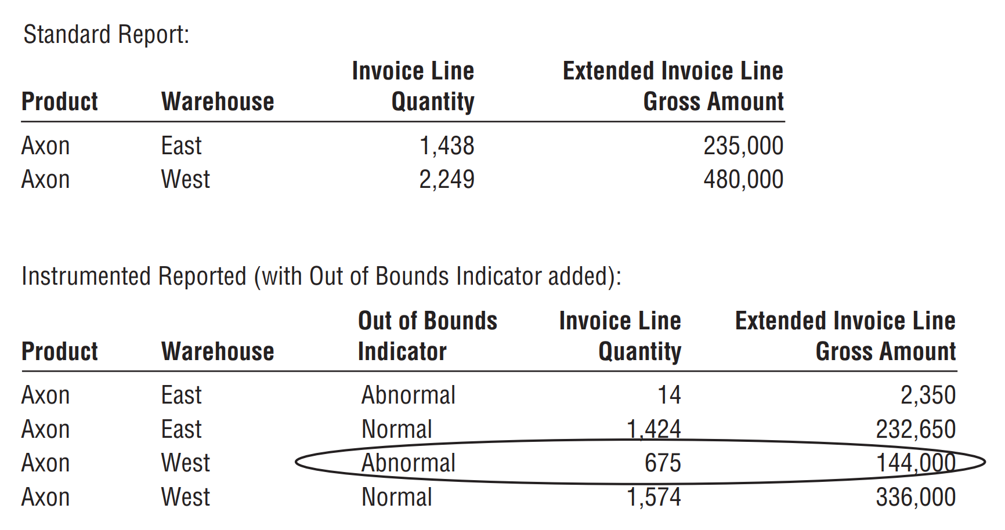
Resulting Invoice Report

Slide 24
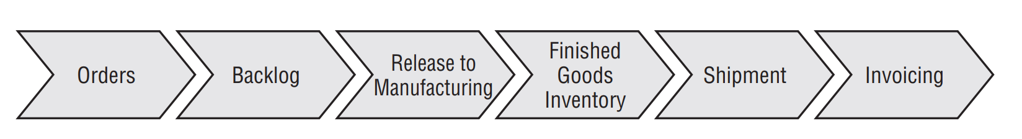
Accumulating Snapshot for the Order Fulfillment Pipeline
Useful when we want to better understand how quickly product move through pipeline:

Slide 25
Accumulating Snapshot for the Order Fulfilment Pipeline
Typically have multiple dates representing major millstones of the process;
Useful when the products moving through the pipeline is uniquely identified;
Electronics equipment with a serial number;
Automobile with a vehicle ID number;
Fits most naturally with short-lived processes;
Lag calculations;

Slide 26
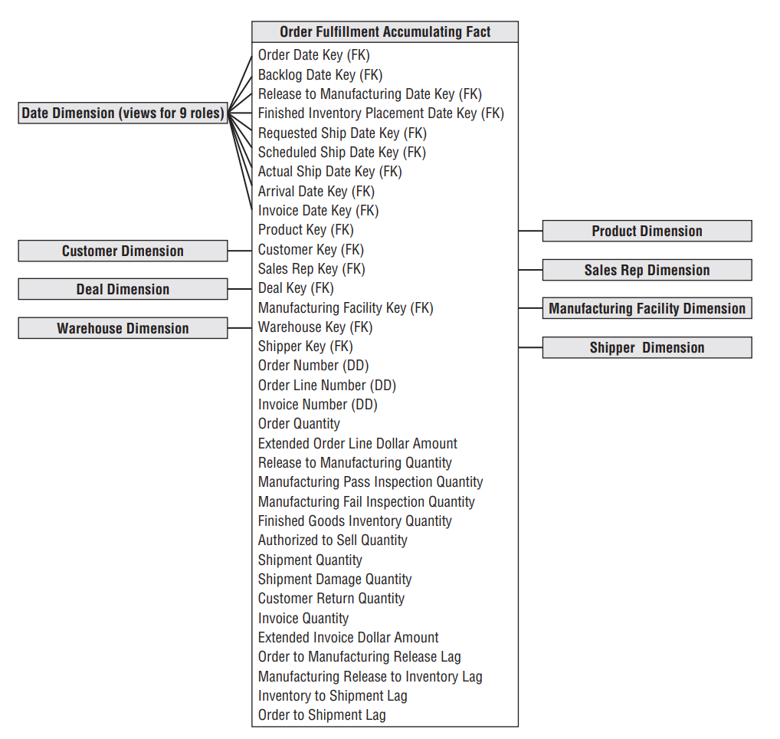
﻿Order fulfillment accumulating snapshot fact table

